Slide 1
Tracing the Origins of
Hindu Dharma
Krishna Maheshwari
Founder, Hindupedia.com
The Online Encyclopedia of Hindu Dharma

Slide 2
Know your past
The past and present are the keys to the future
The past in our case, resolves present day confusion
The past is the core of your roots and who you are

Slide 3
Raise your hand if
You have heard of the Aryan Invasion Theory
You know what the theory states
Believe in the theory
Have not read about how the theory has evolved over the past 20 years
Notes:
A quick check to baseline the audiance

Slide 4
Today’s aim
We know that
  Earliest evidence of our civilization is the Veda
We want to find when
  they were conceived in their present form
Using
  multiple methods known by us today

Slide 5
Veda through the ages
The knowledge contained in the Veda are eternal
They were heard by the Rishi’s multiple times in multiple ages
Passed through an oral tradition
Eventually written down
Had significant portions destroyed
Had insertions with intention to distort
Received by us today

Slide 6

Approaches
Astronomical
Comparative
  Religions
  Civilizations
Archeological
Technological
Scriptural

Slide 7
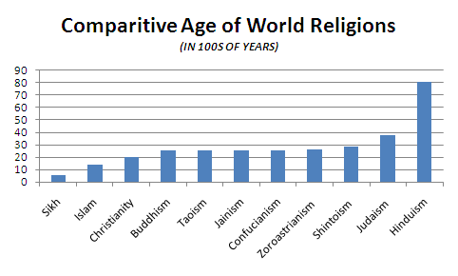
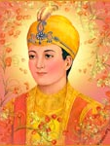
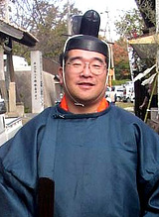

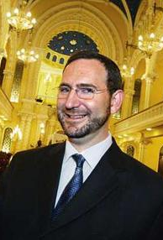

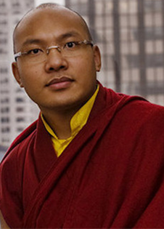
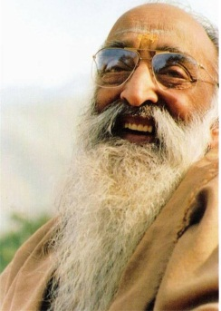
Comparing Religions
To emphasize the relative ages of the major religions we reduce them to proportionate human years, with each 100 years of history representing one year of human life. Viewed this way,
Sikhism, the youngest faith, is five years old.
Islam, the only teenager, is fourteen.
Christianity just turned twenty.
Buddhism, Taoism, Jainism and Confucianism are twenty-five.
Zoroastrianism is twenty-six.
Shintoism is in its late twenties.
Judaism is a mature thirty-seven.
Hinduism, whose birthday remains unknown, is at least eighty years old—the white-bearded grandfather of living spirituality on this planet
Notes:
http://www.hindupedia.com/en/Origins
Flood myths
Similarities in other aspects, stories, knowledge
We expect (atleast until after the development (and reaching of maturity) of the other religions) that there will be a one-way transfer of knowledge/stories/etc (from Hindu dharma to the others)

Slide 8
Comparing Civilizations
Indus Civilization is significantly older than other ancient civilizations based on archeological findings
All other ancient civilizations had an “end” after which there was a cultural/civilizational discontinuity
Notes:
We can see indus impact on other civilizations at their origins, but not vice versa until much later when they are more developed.

Slide 9
Archeological Basis

Slide 10
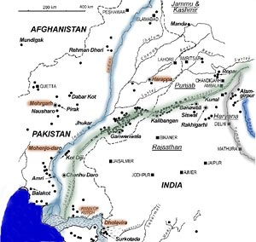
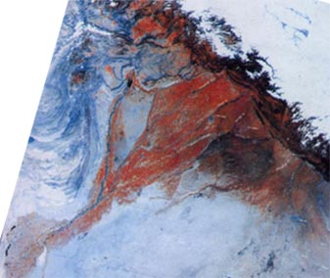
Saraswati River
More than 7 km wide at its widest point at its peak
Stopped going to the sea from the Himalayas between 6000-4000 BC
Completely dry by 1900 BC
Notes:
http://www.stephen-knapp.com/recent_research_on_the_sarasvati_river.htm
http://www.gisdevelopment.net/application/archaeology/site/archs0001.htm
http://sanskrit.safire.com/pdf/ORIGINS.PDF
http://www.eshiusa.org/Articles/Saraswati%20in%20Hindu%20Civilizational%20History%20and%20Culture.pdf
http://www.archaeologyonline.net/artifacts/vedic-civilzation.html

Slide 11
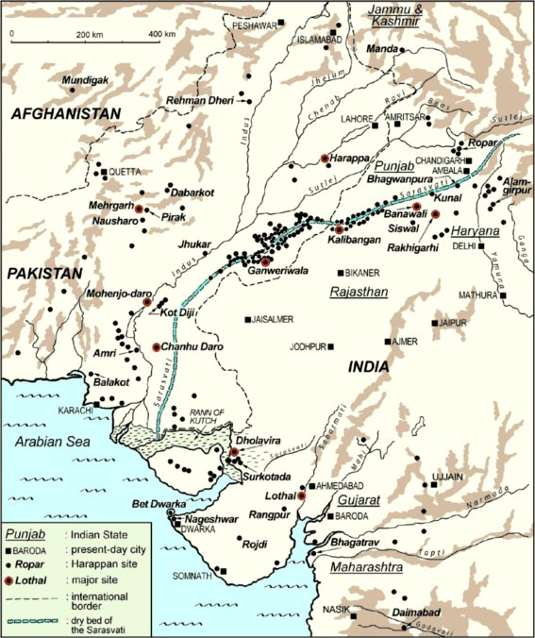
Harappan Civilization
Approximately 2,600 sites covering over 500,000 sq miles (identified so far)
  Modern India covers 1.2M sq miles
7000 BC – 1900 BC
Underwater city in the Gulf of Khambat dated to 7500 BC
Notes:
http://micheldanino.voiceofdharma.com/indus.html

Slide 12
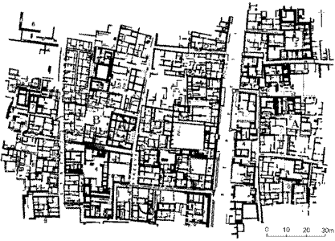
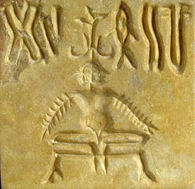
Harappan Civilization
Planned City
North-South streets
Houses opened to the East
Each house had a bathroom and a kitchen
Drainage from houses went in under-street sewers
Cities built to the west of the rivers
City planning follows Stapatya Veda
Yoga
Notes:
Sthapatya Veda describes these rules for city building (basis for vastu shastra)
http://reference.indianetzone.com/1/town_planning.htm

Slide 13
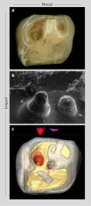
Mehrgarh
Early Harrapan City
Started 7000 BC
Farming
Animal husbandry
Dentistry
  Picture is of drilling in molars
Notes:
Odd that a city dated 7000BC has dentistry. Considering how painful it is, can we suppose some form of anesthesia? Especially considering that the people who had dentistry performed in their molars lived afterwards…

Slide 14
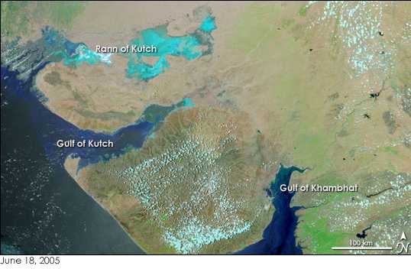
Gulf of Khambhat findings
Early estimates place city during 7500 BC
5 miles long
2 miles wide
Notes:
http://timesofindia.indiatimes.com/cms.dll/html/uncomp/articleshow?msid=782649
That is a pretty large walled city to have that long ago.

Slide 15
Astronomical Basis

Slide 16
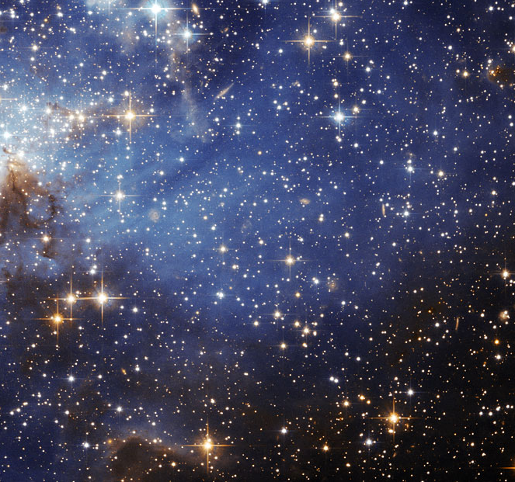
Astronomical Evidence
What do we know based development of astronomy?
Assume naked eye observations
  Accurate to 1/6°
Notes:
We don’t have any evidence of telescopes until much later (jantar mantar, etc)
Assume Rishi’s didn’t get any insight through samadhi, etc for the moment

Slide 17
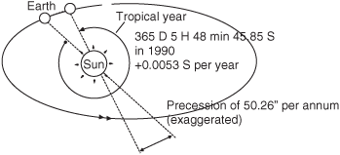
Tropical Year
Tropical year:
  Interval between two vernal equinoxs
Suryasiddhanta: 365.2435374 days
Modern Science: 365.2421897 days (in 2000)
Difference: 1 min, 54.44128 seconds
Notes:
The tropical period of the Sun changes over time…ie the Surya Siddhantha could have been 100% accurate at the time it was written. We have not calculated the period of the tropical year in the ancient past.
http://scienceworld.wolfram.com/astronomy/TropicalYear.html
Image source: http://content.answcdn.com/main/content/img/McGrawHill/Aviation/f0663-02.gif

Slide 18
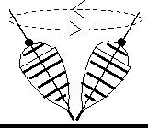
Precession
Requires knowledge of
  Proper Motion of stars
    1000 years to observe Sirius move 1/6 of a degree
  Motion of Earth’s Perihelion
  Period of Equinoxes
Surya Siddhanta:0°0’50.4” / year (or 0.014°)
Year 1900: 0°0’50.2583” / year (or 0.013958°)
Precession
3,600 years of observation
Proper Motion
Perihelion
Equinoxes
Ptolemy: ¼° precession
Notes:
Image source: http://earthobservatory.nasa.gov/Features/Milankovitch/milankovitch_2.php
Image source: http://www.imsc.res.in/~rahul/articles/calendar.html
http://www.daviddarling.info/images/perihelion_advance.jpg
http://religionnerd.net/wp-content/uploads/2010/03/vernal-equinox12.jpg
http://upload.wikimedia.org/wikipedia/commons/9/90/Sirius_proper_motion.gif
http://www.hindupedia.com/en/Astronomy
http://www.new.dli.ernet.in/rawdataupload/upload/insa/INSA_1/20005b5d_183.pdf

Slide 19
Observation Period?
Total time to observe precession to 3 decimal places: not less than 10,000 years
  Accuracy of the Surya Siddhanta: 3 decimal places
Similarly, to measure the tropical period of the Sun to 6 decimal places require not less than 10,000 years
Notes:
Precession changes over time……so Surya Siddhantha could have been more accurate at the time it was written…

Slide 20
Surya Siddhanta
Exact date unknown, but no later than 300 AD
If you assume 300AD and naked eye observations
  beginning of observations are 10,000 BC
  observations are maintained in records that are continuously passed down from astronomer to astronomer over 10,000 years
Alternatively, assume less time and aided observations
Notes:
The Surya Siddhanta (in the 23rd verse of the 1st chapter) dates itself as having been given by Lord Surya at the end of krita yuga. The preceding verse says that Suryasiddhanta was given to sages in previous yugas too, ie in previous krita yugas.

Slide 21
Astronomy of the Veda
Rig Veda
  Winter equinox in Ashwini (7000 BC)
  Revati at the winter solstice (6000 BC)
  Vernal Equinox in Punarvasu (5000-6000BC)
  Vernal equinox in Mrigashira (4000 BC)
Yajur Veda
  Krittika at the winter solstice (8500 BC)
  Purvabhadrapada nakshatra as rising due east (10000 BC)
Notes:
http://sanskrit.safire.com/pdf/ORIGINS.PDF
http://www.vedah.com/org/literature/rigVeda/wrrv/date.asp
http://books.google.com/books?id=DM58BhuR2KwC&pg=PA185&lpg=PA185&dq=vernal+equinox+in+the+rig+veda&source=bl&ots=CB1_IrpLtn&sig=F9p-px5NAih4gM2V1rnVTcb-qqw&hl=en&ei=E2d9TL7CBoL58AaJ1pmZCA&sa=X&oi=book_result&ct=result&resnum=8&ved=0CDAQ6AEwBw#v=onepage&q=vernal%20equinox%20in%20the%20rig%20veda&f=false
Gods, Sages and Kings: Vedic Secrets of Ancient Civilization By David Frawley

Slide 22
Astronomical Dating Problems
27 Nakshatras
Nakshatra lasts 955 years
Cycle repeats every 25,675 years
To find when an equinox was in a nakshatra:
years ago where N >= 0
Inner Limit | (N x 25,675)+7,634
Outer Limit | (N x 25,675)+9,542

Slide 23
Ramayana
Rama
Hanuman
Jamvant
Dating much more uncertain
Contains lots of astronomical details
Self dates to Treta Yuga
Valmiki referred to in the Yajurveda
Does not discuss the Saraswati River
Notes:
Dvapara-Yuga: 864,000 (http://www.hindupedia.com/en/Astronomy)
Thus Treta yuga ended roughly .8M years ago (Kali began ~3000 BC) and lasted 1,296,000 years. If we look at treta yuga properly (which is when the ramayana took place), than that is roughly 1M years ago.
Rama picture: http://1.bp.blogspot.com/_g4zJ-O_EKdQ/Szocr-dp_vI/AAAAAAAAAwg/ZRnjcObNduA/s320/Bhagwan+Rama.jpg
Hanuman picture:http://srirammandirdwarka.org/yahoo_site_admin/assets/images/lord-hanuman_2.229221900.jpg
Jamvant picture: http://i46.tinypic.com/eumplc.jpg
Valmiki referred to in the Taittiriya Brahmana in the Yajurveda

Slide 24
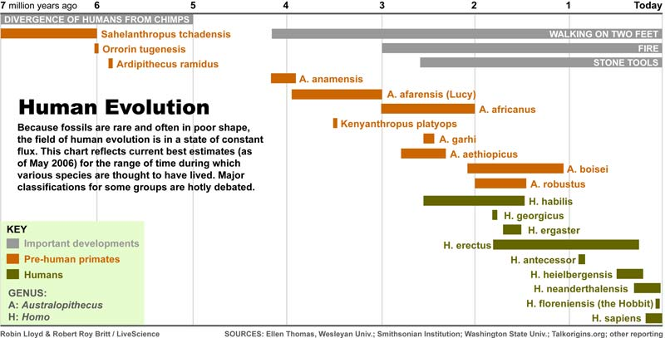
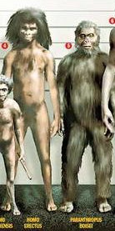
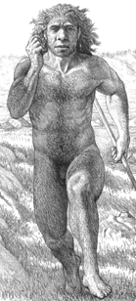
Ramayana?
Notes:
Lets speculate for a moment…

Slide 25
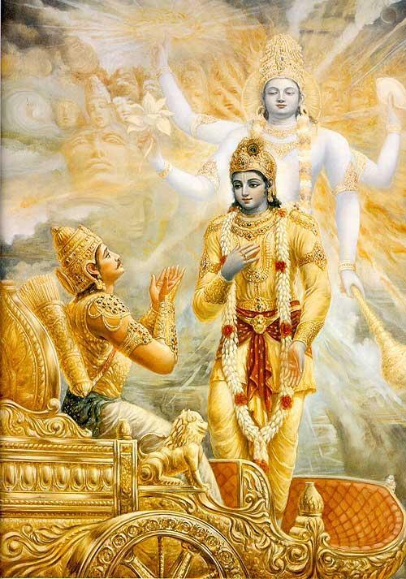
Mahabharata
Dating
  5500 BC and 1100 BC
  Based on astronomy, lists of Kings, etc
Possible co-incidence with archeological evidence
140 astronomical references
Discovery of submerged Dwarka off the coast of Dwarka
  Containing a seal mentioned in the Mahabharata
  Apparently on land reclaimed from the sea
Refers to Saraswati as a seasonal river
Notes:
http://www.hindunet.org/hindu_history/ancient/mahabharat/mahab_vartak.html
Bet Dwarka is one of 6/7 Dwarka’s that got flooded. We have yet to discover the others…so don’t know if that is Lord Krishna’s city or not.
Dating is based on astronomical occurances that happened within the defined date range of 5500 BC and 1100BC…no one has thought to look at older occurances…

Slide 26
Technological Basis

Slide 27
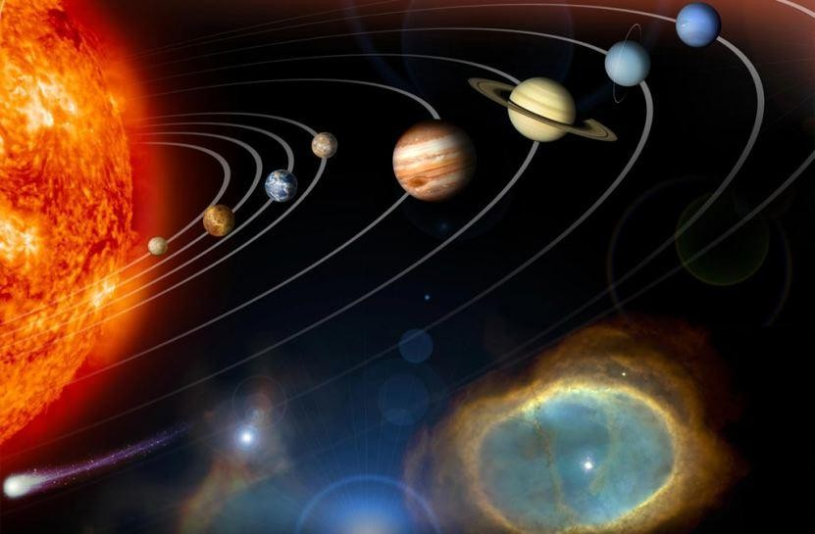
Rigveda
Vehicles
  Jalayan
    a vehicle designed to operate in air and water
  Kaara
    a vehicle that operates on ground and in water
  Tritala
    a vehicle consisting of three stories
  Trichakra Ratha
    a three-wheeled vehicle designed to operate in the air
  Vaayu Ratha
    a gas or wind-powered chariot
  Vidyut Ratha
    a vehicle that operates on power
The Earth is held in space by the Sun
Earth being round and in solar orbit
  The Sun does never set nor rise. When people think the Sun is setting (it is not so). For after having arrived at the end of the day it makes itself produce two opposite effects, making night to what is below and day to what is on the other side…Having reached the end of the night, it makes itself produce two opposite effects, making day to what is below and night to what is on the other side. In fact, the Sun never sets….”
Error Correcting Codes & Encryption
Notes:
Rig Veda 6.58.3: Jalayan
Rig Veda 9.14.1: Kaara-Kaara…
Rig Veda 3.14.1: Tritala…
Rig Veda 4.36.1: Trichakra Ratha
Rig Veda 5.41.6: Vaayu Ratha
Rig Veda 3.14.1: Vidyut Ratha
Aitareya brahmana 3.44 (Rig Veda): Sun rise/etc
Image: http://files.myopera.com/Weatherlawyer/albums/643041/Solar%20System.jpg

Slide 28
Other Scriptures
Multiple types of Viman-s
  their construction, their properties, etc
Time Measurement:
  truti, lasting 1/1,000,0000 of a second
  mahamantavara of 311 trillion years
Water life cycle
  Water ascends towards the sky in vapors;
  from the sun it descends in rain,
  from the rains are born the plants,
  from the plants, animals
Age of the earth at more than 4 billion years
Relativity of Time
Notes:
http://hinduwisdom.info/Advanced_Concepts.htm

Slide 29
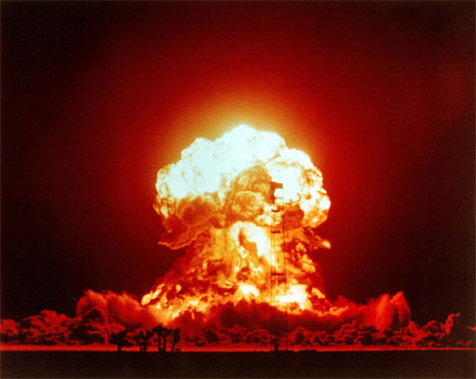
Mahabharata War
Nuclear Weapons?
  Agneya Astra
    a blazing shaft possessed of the effulgence of a smokeless fire, and let it off on all sides,…Endued with fiery flames…Meteors flashed down…A thick gloom suddenly shrouded the (Pandava) host. All the points of the compass also were enveloped by that darkness...Inauspicious winds began to blow. The sun himself no longer gave any heat…The very elements seemed to be perturbed...The universe, scorched with heat, seemed to be in a fever…The very waters heated, the creatures residing in that element…seemed to burn. From all the points of the compass, cardinal and subsidiary, from the firmament and the very earth, showers of sharp and fierce arrows fell and issued with the impetuosity of Garuda or the wind…the hostile warriors fell down like trees burnt down by a raging fire. Huge elephants, burnt by that weapon, fell down on the earth all around, uttering fierce cries loud as the rumblings of the clouds…The steeds, O king, and the cars also, burnt by the energy of that weapon, looked, O sire, like the tops of trees burnt in a forest-fire. Thousands of cars fell down on all sides. Indeed, O Bharata, it seemed that the divine lord Agni burnt the (Pandava) host in that battle, like the Samvarta fire consuming everything at the end of the Yuga…Burnt by the energy of Aswatthaman's weapon, the forms of the slain could not be distinguished.
    a full Akshauhini [218,700] of the Pandava troops killed
  Hiroshima: 60,000-80,000 killed
  Nagasaki: 90,000-166,000 killed
Non-lethal weapons:
  Sanmohana, Pramohana
    And entirely covering the cardinal and other directions with sharp
    and keen-edged arrows furnished with beautiful feathers, that mighty
    hero stupefied their senses with the twang of the Gandiva.
  Prajna weapon neutralizes the effects of the Pramohana
Death Toll:
  Mahabharata: 3.9M warriors killed over 17 days, at least 1.5M killed
  on day 14
  World War I: 9.7M soldiers killed over 4 years
  World War II: 22-25M soldiers killed over 6 years
Notes:
http://www.hindupedia.com/en/Abhimanyu
Mahabharata, Virata Parva, LXV (sanmohana)
Mahabharata, Bhishma Parva, LXXXVII (Pramohana, Prajna)
Mahabharata, Drona Parva, CCI (Agneya)
Translation of Mahabharata into English published 1883 to 1896 by Kisari Mohan Ganguli (1842-1895)
Agneya:
The valiant Aswatthaman,
then, staying resolutely on his car, touched water and invoked the Agneya
weapon incapable of being resisted by the very gods. Aiming at all his
visible and invisible foes, the preceptor's son, that slayer of hostile
heroes, inspired with mantras a blazing shaft possessed of the effulgence
of a smokeless fire, and let it off on all sides, filled with rage. Dense
showers of arrows then issued from it in the welkin. Endued with fiery
flames, those arrows encompassed Partha on all sides. Meteors flashed
down from the firmament. A thick gloom suddenly shrouded the (Pandava)
host. All the points of the compass also were enveloped by that darkness.
Rakshasas and Pisachas, crowding together, uttered fierce cries.
Inauspicious winds began to blow. The sun himself no longer gave any
heat. Ravens fiercely croaked on all sides. Clouds roared in the welkin,
showering blood. Birds and beasts and kine, and Munis of high vows and
souls under complete control, became exceedingly uneasy. The very
elements seemed to be perturbed. The sun seemed to turn. The universe,
scorched with heat, seemed to be in a fever. The elephants and other
creatures of the land, scorched by the energy of that weapon, ran in
fright, breathing heavily and desirous of protection against that
terrible force. The very waters heated, the creatures residing in that
element, O Bharata, became exceedingly uneasy and seemed to burn. From
all the points of the compass, cardinal and subsidiary, from the
firmament and the very earth, showers of sharp and fierce arrows fell and
issued with the impetuosity of Garuda or the wind. Struck and burnt by
those shafts of Aswatthaman that were all endued with the impetuosity of
the thunder, the hostile warriors fell down like trees burnt down by a
raging fire. Huge elephants, burnt by that weapon, fell down on the earth
all around, uttering fierce cries loud as the rumblings of the clouds.
Other huge elephants, scorched by that fire, ran hither and thither, and
roared aloud in fear, as if in the midst of a forest conflagration. The
steeds, O king, and the cars also, burnt by the energy of that weapon,
looked, O sire, like the tops of trees burnt in a forest-fire. Thousands
of cars fell down on all sides. Indeed, O Bharata, it seemed that the
divine lord Agni burnt the (Pandava) host in that battle, like the
Samvarta fire consuming everything at the end of the Yuga.
Then Arjuna, O king, invoked into
existence the Brahma weapon, capable of baffling every other weapon, as
ordained by the Lotus-born (Brahma) himself. Within a moment that
darkness was dispelled, cool winds began to blow, and all the points of
the compass became clear and bright.
We then beheld a wonderful sight,
a full Akshauhini (of the Pandava troops) laid low. Burnt by the
energy of Aswatthaman's weapon, the forms of the slain could not be
distinguished.
Then those two heroic and mighty bowmen, viz., Kesava and
Arjuna, freed from that darkness, were seen together, like the sun and
the moon in the firmament.
Indeed, the wielder of Gandiva and Kesava were
both unwounded. Equipped with its banners and standards and steeds, with
the Anukarsa unjoined; and with all the mighty weapons stored on it
remaining uninjured, that car, so terrible to thy warriors, freed from
that darkness, shone resplendent on the field.
Image: http://www.allamericanpatriots.com/photos/mushroom-cloud

Slide 30
Scriptural Basis

Slide 31
Textual Development
Shastra as Siddhanta
  Siddha: the goal, the achievement - siddha
  Anta: is reached, or its end
  Final attainments or conclusions
Are the culmination of a long process of discussion, criticism and review
  Grammar (85 grammarians known before Panini)
  Vedanta (many teachers)
Veda are direct in their statements
  Yet, speak in many tongues
  Requires solidified thought
  Communicated in a mature language
Whatever the origin date, need to add period for development of technology & thought
Notes:
Siva Senani Nori – email discussion
http://sanskrit.safire.com/pdf/ORIGINS.PDF
1900+ years to develop if assumed to be human thought

Slide 32
Scriptural mentions of Saraswati
Rig Veda mentions Saraswati River 60+ times
  “mighty river flowing from the mountains to the sea”
Mahabharata
  as a seasonal river
  dried up in a desert (at a place named Vinasana or Adarsana)
  disappeared in the desert
  reappears in some places
  and joins the sea "impetuously"
Notes:
http://sanskrit.safire.com/pdf/ORIGINS.PDF
Mhb. 3.82.111; 3.130.3; 6.7.47; 6.37.1-4., 9.34.81; 9.37.1-2
Mbh. 3.80.118
Mbh. 3.88.2

Slide 33
Scriptural References
The Surya Siddhanta
  Dates itself as having been given by Lord Surya at the end of krita yuga
  Also states that it was given to sages in previous yugas too (ie in previous krita yugas)
Many scriptures give similar dates
Notes:
Surya Siddhanta: in the 23rd verse of the 1st chapter

Slide 34
Limitations
Increasing compression of information over time
Perspective
  Idea centric vs event centric
  Event centric vs person centric
Not historical texts for the most part

Slide 35
Conclusion
Archeological View
  7,500 BC based on earliest finds
Astronomical View
  10,000 BC or change in assumptions
Technological View
  At least 2000 years prior to Rig Veda
  Doesn’t explain loss of technology of Harappa
Scriptural View
  Much older…multiple presentations over multiple yugas
  Creates cognitive dissonance
Notes:
http://ancientindians.net/technology/astronomical-instruments-gola-bandha-gola-yantra/

Slide 36
Hindupedia.com
The online encyclopedia of Hindu Dharma

Slide 37
Hindupedia.com
First, online encyclopedia of Hindu Dharma
Wide range of topics
Mission to
  Provide college students and academics a base of knowledge to leverage
  Enable curriculum development at all levels
  Support curriculum change related activities
  Give voice to the teachings enshrined in the guru-shishya parampara
  Provide an internal perspective
933 articles (today), 20,000+ monthly visitors

Slide 38
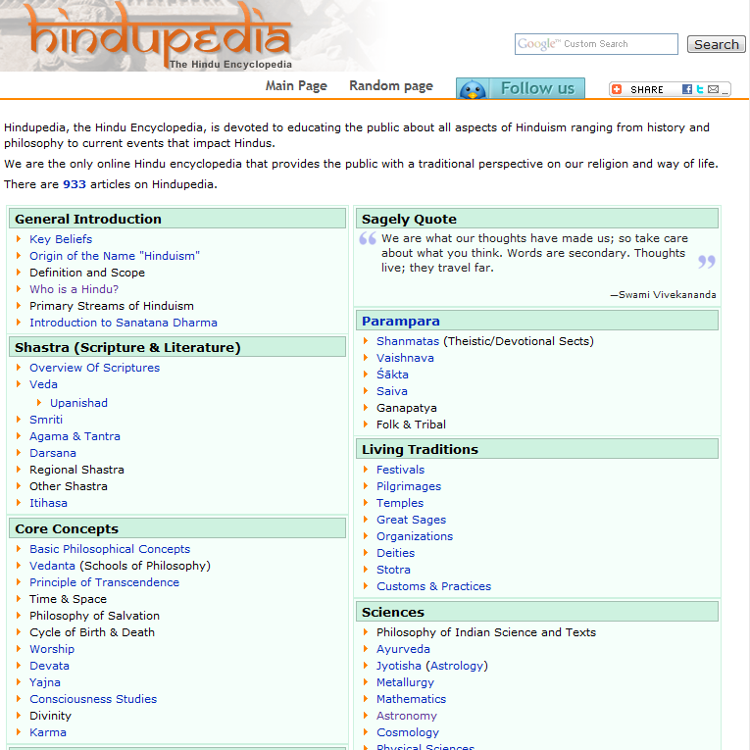

Slide 39
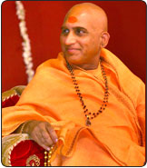
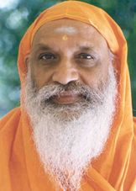


The Team
Advisory Board
Editorial Board
5 researchers
2 editors
30 content reviewers
2 online marketers
Notes:
Left to Right:
Swami Avdheshananda Giri – Head acharya, mahamandaleshvar of Juna Akahada, On Astha, Sanskar every day with his Bhagavad Katha, and the first person to bathe during the Kumbha Mela
Swami Dayananda Saraswati – founder of Acharya Sabha (and first attempt to unify all sects of our dharma)
Dr. David Frawley – reknowned jyothish and ayurvedic doctor. He is also the first westerner to get a title ‘Shastri’ from a reputed institute in India
Swamini Sadvidyananda Saraswati – expert Vedanta lecturer, desciple of Swami Dayanandaji.

Slide 40
Q&A
Notes:
Notes
Have action items (how can you help
Follow up with chandak uncle for india connections
Have a why not section…ie aryan invasion and the effort to fight it

